Slide 1
Suffixes 2
Suffixes for Superlative Adjectives

Slide 2
Key Information
A suffix is a letter or a group of letters which are added to the end of a word to change its meaning. For example: ‘-er' added to 'teach' makes 'teacher’.
An adjective is a word which describes a noun to give more information about it. For example: beautiful, blue, tall, quiet
A superlative adjective is the form of an adjective that describes the highest or lowest option of a group. For example: tallest, shortest, brightest
Vowels are specific letters in the alphabet. They are A, E, I, O and U.
A consonant is a letter of the alphabet which is not a vowel. For example: x, k, g

Slide 3
Let’s start with a question about adding the suffix ‘er’ to form comparative adjectives, which is linked to the new learning later in this lesson.

Slide 4
Add the ‘er’ suffix to the words below to turn them into comparative adjectives.
Root word | Comparative adjective
fast
big
itchy
nice
soft

Slide 5
Add the ‘er’ suffix to the words below to turn them into comparative adjectives.
Root word | Comparative adjective
fast | faster
big | bigger
itchy | itchier
nice | nicer
soft | softer

Slide 6
Now that we are ready to move on, we can learn about adding the suffix ‘est’ to form superlative adjectives.

Slide 7
When two items are compared, we often use comparative adjectives. Comparative adjectives are formed by adding the suffix ‘er’ to an adjective.
tall + er = taller
The giraffe is taller than the elephant.

Slide 8
When two or more items are compared, we can also use superlative adjectives. Superlative adjectives are formed by adding the suffix ‘est’ to an adjective.
short + est = shortest
tall + est = tallest
The zebra is the shortest.
The giraffe is the tallest.

Slide 9
The spelling of many adjectives remains unchanged when we add the ‘est’ suffix.
adjective
suffix
superlative adjective
+
=
short
est
shortest
+
=
wild
est
wildest
+
=
quiet
est
quietest
+
=
broad
est
broadest

Slide 10
Complete the table below.
Root word | Superlative adjective
fast
hard
cold
loud
soft

Slide 11
Complete the table below.
Root word | Superlative adjective
fast | fastest
hard | hardest
cold | coldest
loud | loudest
soft | softest

Slide 12
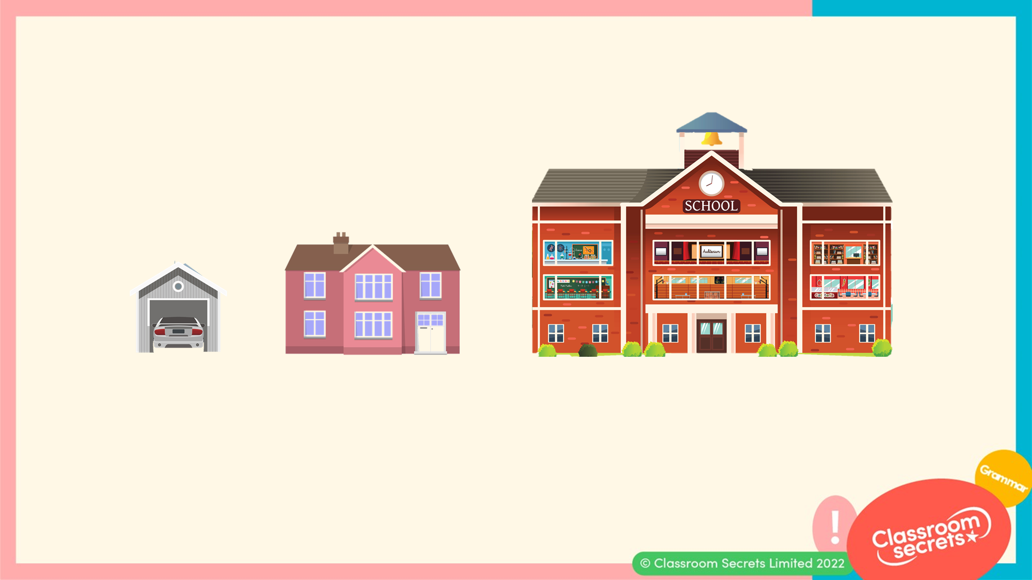
However, if an adjective ends with the letter ‘e’, we remove the ‘e’ before adding the suffix ‘est’.
large + est = largest
The school is the largest building.

Slide 13
Here are some more examples.
adjective
suffix
superlative adjective
close
+
est
=
closest
wide
+
est
=
widest
large
+
est
=
largest
wise
+
est
=
wisest

Slide 14
If an adjective ends with the letter ‘y’, we change the ‘y’ for the letter ‘i’ before we add the suffix ‘est’.
heavy + est = heaviest
The elephant is the heaviest.

Slide 15
Here are some more examples.
adjective
suffix
superlative adjective
+
+
=
bumpy
i
est
bumpiest
+
+
=
icy
i
est
iciest
+
+
=
tiny
i
est
tiniest
+
+
=
shiny
i
est
shiniest

Slide 16
For each pair, tick the correct spelling.
A. | palest |  |  | paleest
B. | easyest |  |  | easiest
C. | angriest |  |  | angrest
D. | strangiest |  |  | strangest

Slide 17
For each pair, tick the correct spelling.
A. | palest |  |  | paleest
B. | easyest |  |  | easiest | 
C. | angriest |  |  | angrest
D. | strangiest |  |  | strangest | 

Slide 18
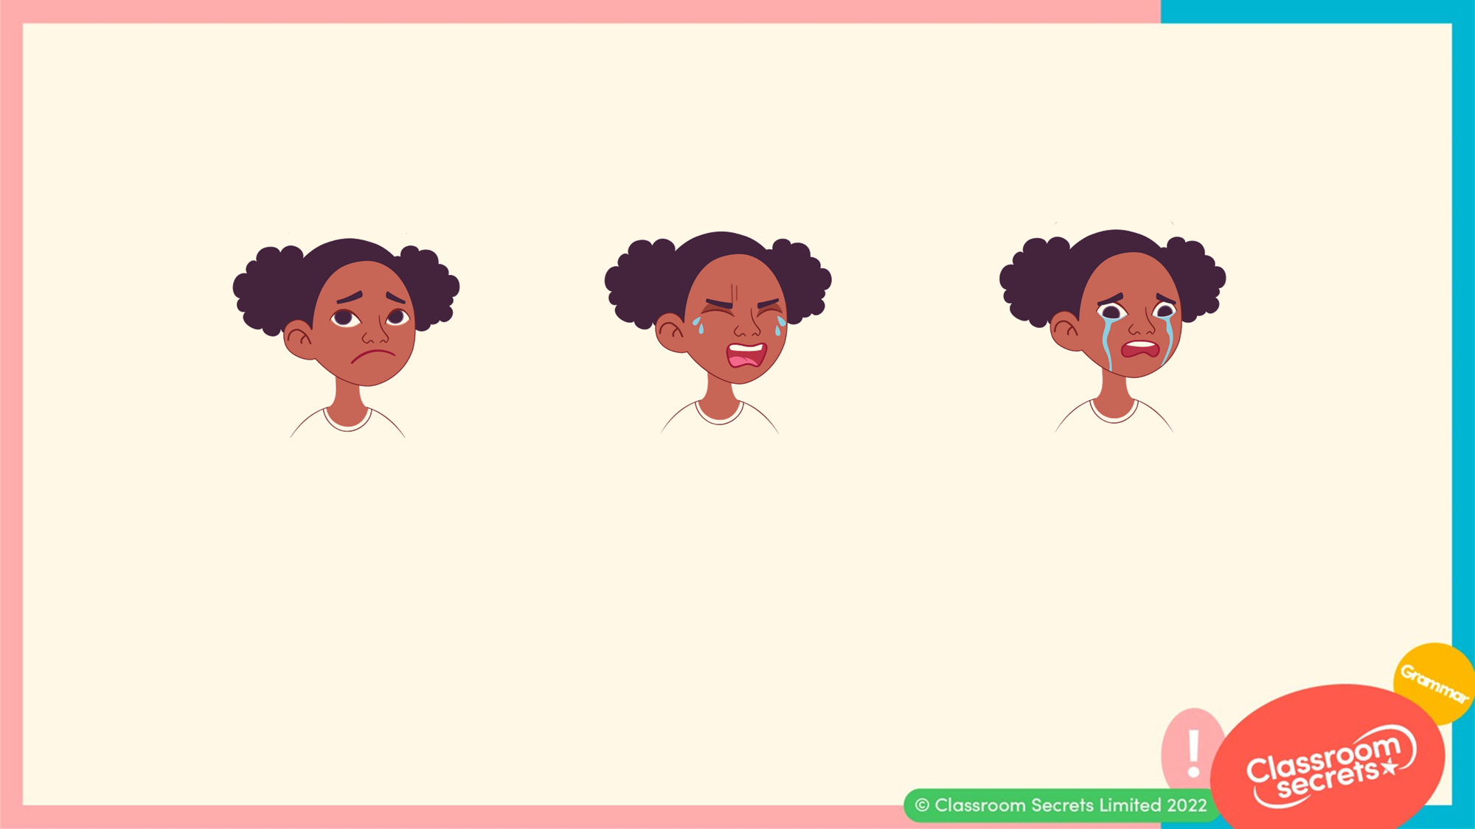
If an adjective has a short vowel sound and ends with a consonant, we have to double the last letter before we can add the suffix ‘est’.
sad + d + est = saddest
Amy thinks this is the saddest she has ever felt.

Slide 19
Here are some more examples.
adjective
suffix
superlative adjective
big
+
g
+
est
=
biggest
red
+
d
+
est
=
reddest
hot
+
t
+
est
=
hottest
thin
+
n
+
est
=
thinnest

Slide 20
Complete the table below.
Root word | Superlative adjective
flat
wet
dim
fit
mad

Slide 21
Complete the table below.
Root word | Superlative adjective
flat | flattest
wet | wettest
dim | dimmest
fit | fittest
mad | maddest

Slide 22
Some adjectives change completely when they are turned into superlative adjectives and the suffix ‘est’ is not used.
adjective
superlative adjective
good
=
best
bad
=
worst
=
many
most

Slide 23
With many superlative adjectives, we often add the word ‘the’ when using them in a sentence.
That pantomime was the funniest I’ve ever seen.
Mum said the latest I can get up is eight o’clock.
I have the messiest bedroom in our house.

Slide 24
Some adjectives are turned into superlative adjectives by adding either ‘least’ or ‘most’ instead of adding the ‘est’ suffix.
The rose is the most beautiful flower I have ever seen.
I bought the least expensive trainers I could find.
We saw the most gigantic sky scraper in London.

Slide 25
Which sentences are correct?
A. I had the goodest birthday party.
B. Tom won the most games.
C. Mum made me tastiest birthday cake.
D. It was the creamiest cake I had ever tasted.

Slide 26
Which sentences are correct?
A. I had the goodest birthday party.
B. Tom won the most games.
C. Mum made me tastiest birthday cake.
D. It was the creamiest cake I had ever tasted.
A should say ‘I had the best birthday party.’
C should say ‘Mum made me the tastiest birthday cake.’

Slide 27
Now that we know how to add the suffix ‘est’ to form superlative adjectives, let’s apply our learning to some further application and reasoning questions.

Slide 28
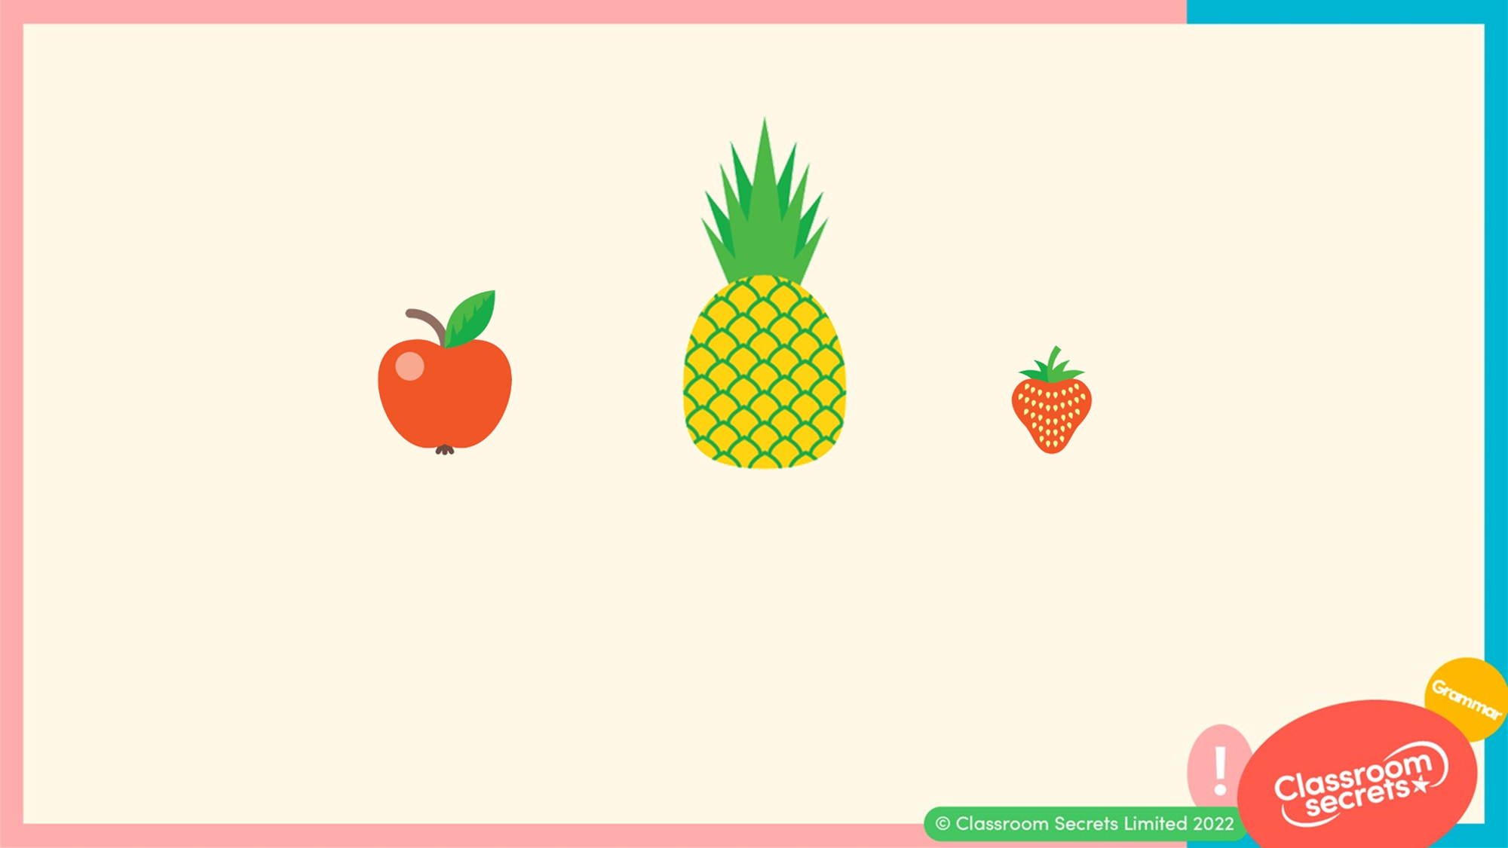
Using a superlative adjective, write a sentence about the fruit.

Slide 29
Using a superlative adjective, write a sentence about the fruit.
Various answers, for example:
That was the sweetest pineapple I have ever tasted.

Slide 30
Jack has added the suffix ‘est’ to the adjective ‘funny’ and used the new word in a sentence.
My friend told me funnyest joke I have ever heard.
Is he correct? Explain your answer.

Slide 31
Jack has added the suffix ‘est’ to the adjective ‘funny’ and used the new word in a sentence.
My friend told me funnyest joke I have ever heard.
Is he correct? Explain your answer.
Jack is incorrect because...

Slide 32
Jack has added the suffix ‘est’ to the adjective ‘funny’ and used the new word in a sentence.
My friend told me funnyest joke I have ever heard.
Is he correct? Explain your answer.
Jack is incorrect because he should have changed the ‘y’ at the end of ‘funny’ to an ‘i’. He also should have added the word ‘the’ to the sentence. The sentence should say:
My friend told me the funniest joke I have ever heard.

Slide 33
You’re ready to progress!
Now apply your learning by trying some questions.

Slide 34
Join each root word to its superlative.
tiny |  | thinnest
thin |  | tallest
tall |  | tiniest
Varied Fluency 1

Slide 35
Join each root word to its superlative.
tiny |  | thinnest
thin |  | tallest
tall |  | tiniest
Varied Fluency 1

Slide 36
Tick the correct spelling of the superlative to match the adjective below.
slim
slimest |  |  | slimmest
Varied Fluency 2

Slide 37
Tick the correct spelling of the superlative to match the adjective below.
slim
slimest |  |  | slimmest | ✓
Varied Fluency 2

Slide 38
True or false? The superlative adjective is used correctly in the sentence below.
My brother is the most bravest person I know.
Varied Fluency 3

Slide 39
True or false? The superlative adjective is used correctly in the sentence below.
My brother is the most bravest person I know.
False. The word ‘most’ is not needed in this sentence.
Varied Fluency 3

Slide 40
Complete the table by correctly adding the ‘est’ suffix to the root words.
Root word | Superlative Adjective
nice
early
fit
strong
Varied Fluency 4

Slide 41
Complete the table by correctly adding the ‘est’ suffix to the root words.
Root word | Superlative Adjective
nice | nicest
early | earliest
fit | fittest
strong | strongest
Varied Fluency 4

Slide 42
Use the superlative adjectives to create a sentence about the images below.
longest
warmest
Application 1

Slide 43
Use the superlative adjectives to create a sentence about the images below.
Various answers, for example:
It was a very cold day so I put on my warmest jumper and my longest scarf.
longest
warmest
Application 1

Slide 44
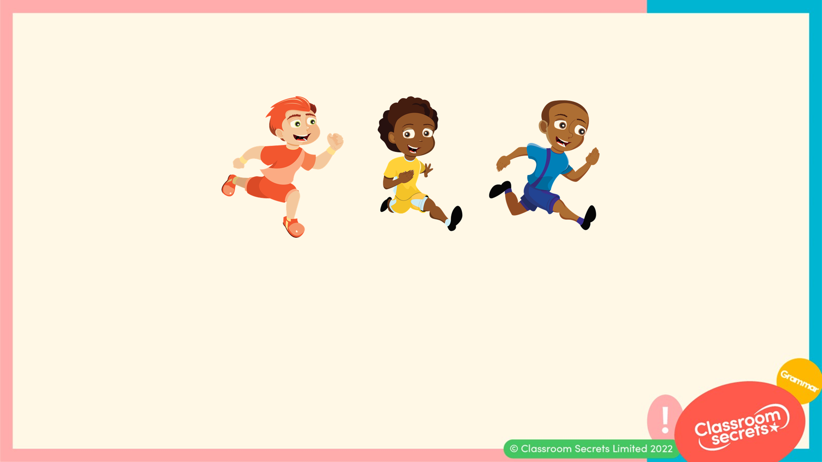
Complete the sentence using a superlative adjective.
The runner won the race.
Application 2

Slide 45
Complete the sentence using a superlative adjective.
Various answers, for example:
The fastest runner won the race.
Application 2

Slide 46
Mark Maisie’s spelling test.
Explain any mistakes she has made.
sharpest
hottest
cuteest
silliest
Reasoning 1

Slide 47
Mark Maisie’s spelling test.
Explain any mistakes she has made.
Maisie has written ‘cuteest’ incorrectly because...
sharpest
hottest
cuteest
silliest
✓
✓
x
✓
Reasoning 1

Slide 48
Mark Maisie’s spelling test.
Explain any mistakes she has made.
Maisie has written ‘cuteest’ incorrectly because she should have removed the ‘e’ before adding the suffix ‘est’. The correct spelling is:
cutest
sharpest
hottest
cuteest
silliest
✓
✓
x
✓
Reasoning 1

